Slide 1



Deep Learning Artificial Intelligence Technology, from Toronto MicroElectronics Inc.
Toronto MicroElectronics

Slide 2
Deep Learning Artificial Intelligence Technology, from Toronto MicroElectronics Inc.
About Us
Founded in Mississauga
Over 30 years of design & manufacturing experience
Serving multiple industries
Five different brands under one roof

Slide 3
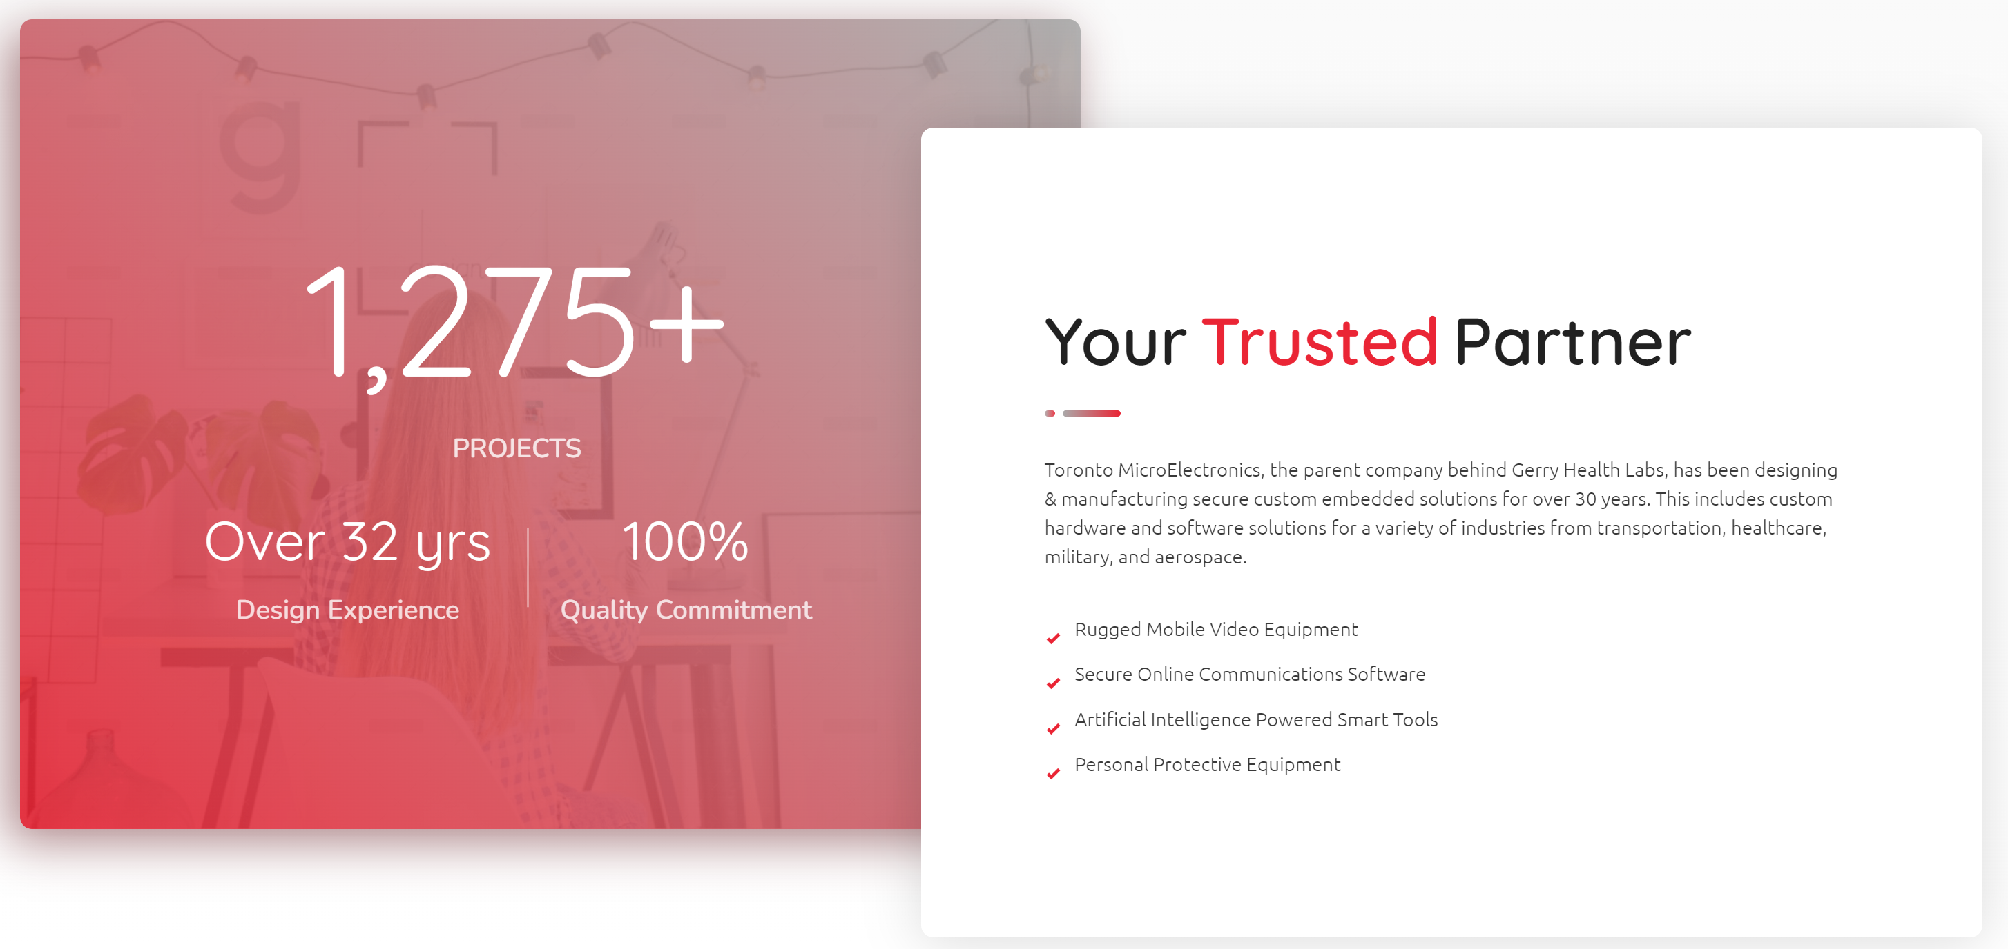
Deep Learning Artificial Intelligence Technology, from Toronto MicroElectronics Inc.
About Us

Slide 4

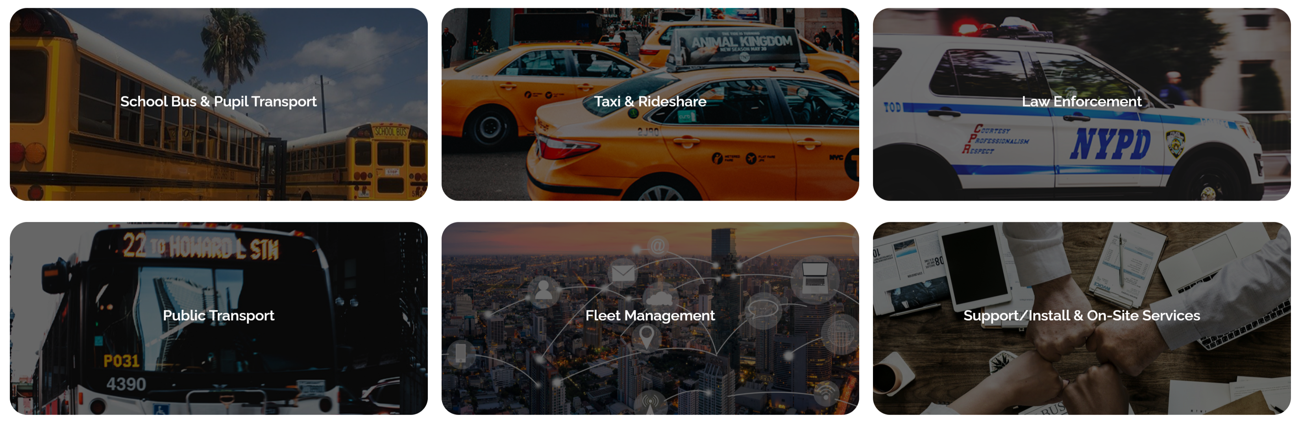
Deep Learning Artificial Intelligence Technology, from Toronto MicroElectronics Inc.
247Security Inc
Mobile video security experts
Video & Fleet management systems for
  School Bus
  Public Transit
  Taxi & Rideshare
  Law Enforcement
Manufactured in Ontario
All Support, Service & Marketing is done locally

Slide 5
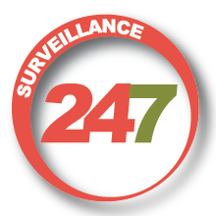
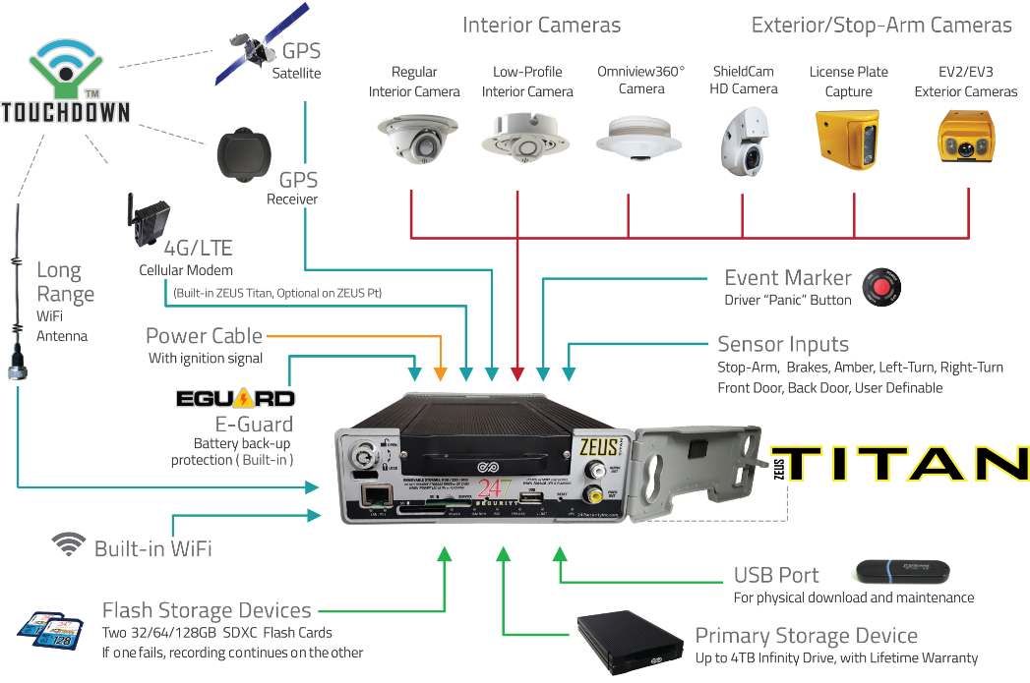
Deep Learning Artificial Intelligence Technology, from Toronto MicroElectronics Inc.
Surveillance 247
Exclusive distributor, installer,
service provider for 247Security products
On-Site service plans
All Support, Service & Marketing is done locally

Slide 6


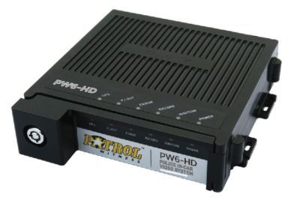
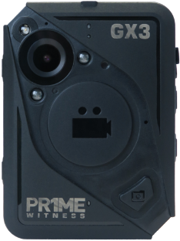
Deep Learning Artificial Intelligence Technology, from Toronto MicroElectronics Inc.
Patrol Witness
Exclusive Law Enforcement Video Technology
Made and supported in Ontario
  In-Vehicle Video
  Body-Worn Video
  Review Software
  Fleet Management

Slide 7


Deep Learning Artificial Intelligence Technology, from Toronto MicroElectronics Inc.
Gerry Health Labs
Innovative Health & Senior Care Products
Made and supported in Ontario
Three Sub-Brands
  Gerry Connect
  Gerry Vivo
  Ventum Labs

Slide 8

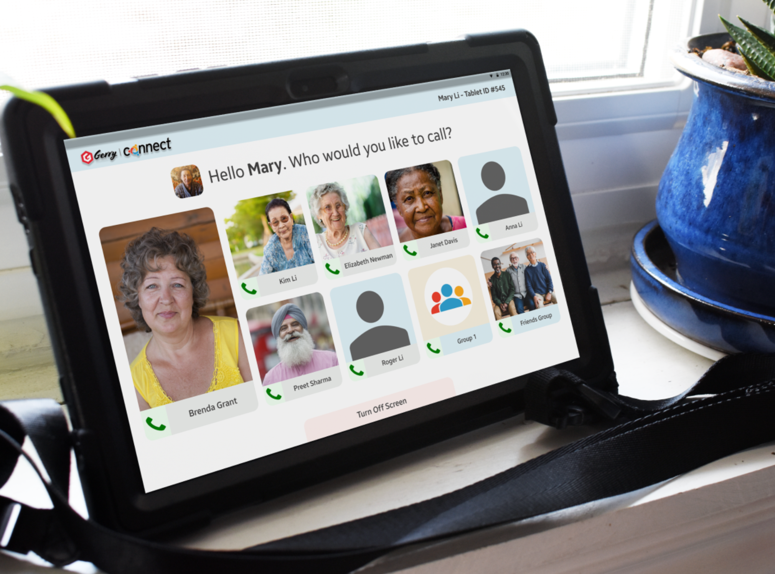
Deep Learning Artificial Intelligence Technology, from Toronto MicroElectronics Inc.
Gerry Connect
Video communications system designed for seniors and LTC applications
Made and supported in Ontario
Nationwide Pilot Programme

Slide 9

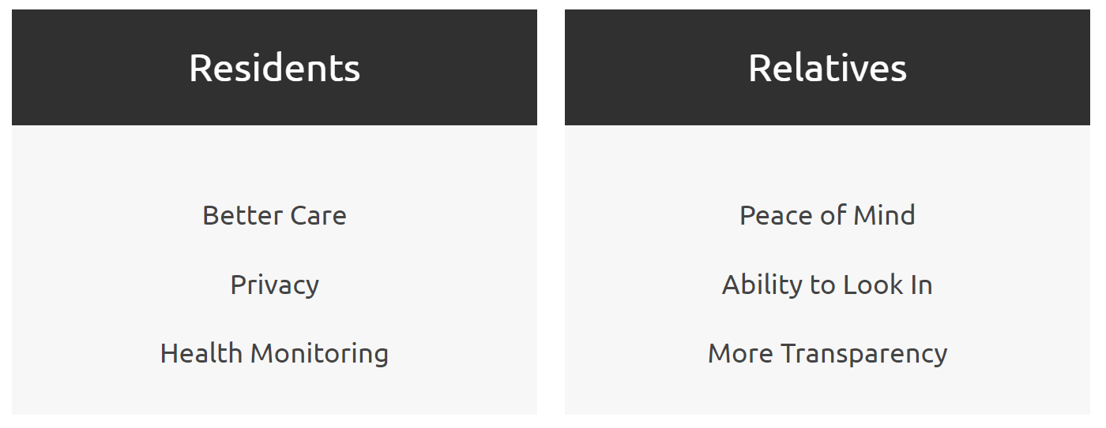
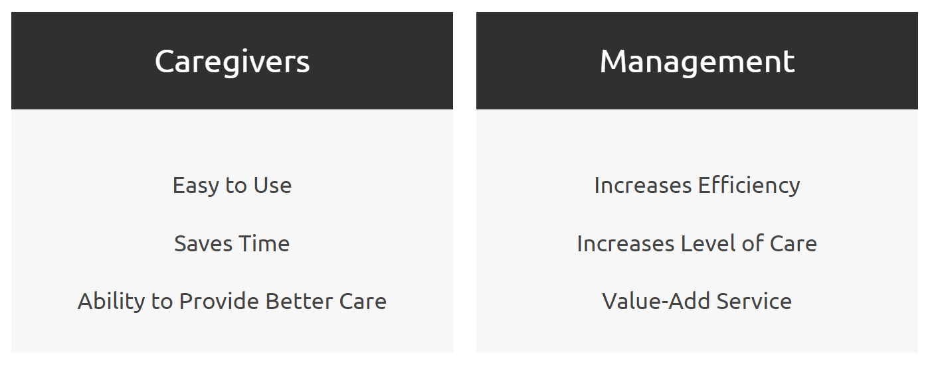
Deep Learning Artificial Intelligence Technology, from Toronto MicroElectronics Inc.
Gerry Vivo
AI based health monitoring system for LTC and retirement environment
  Privacy based non-video observation
  Human movement is recognized by proprietary algorithm
  Automatic notification system for staff
  Increase standard of care for residents, peace of mind for family, decrease pressure on staff

Slide 10

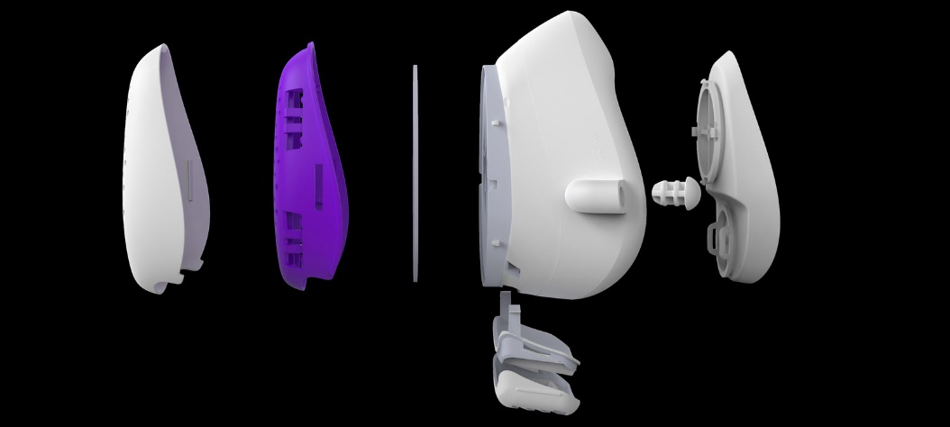
Deep Learning Artificial Intelligence Technology, from Toronto MicroElectronics Inc.
Ventum Labs
Ultra-High Effiency respiratory protection, without the bulk
Protection for industrial and personal use
  Factories, woodwork, asbestos, shooting ranges, painting, etc.
Certification in process
Designed & manufactured right here in Mississauga

Slide 11


| Canadian Innovation
Our team is composed of designers and engineers with over 30 years of experience in hardware and software, security, and artificial intelligence technology.
Headquartered in Mississauga, Ontario, this is Canadian innovation.

